Slide 1
Writing
Supplemental Reports

Slide 2
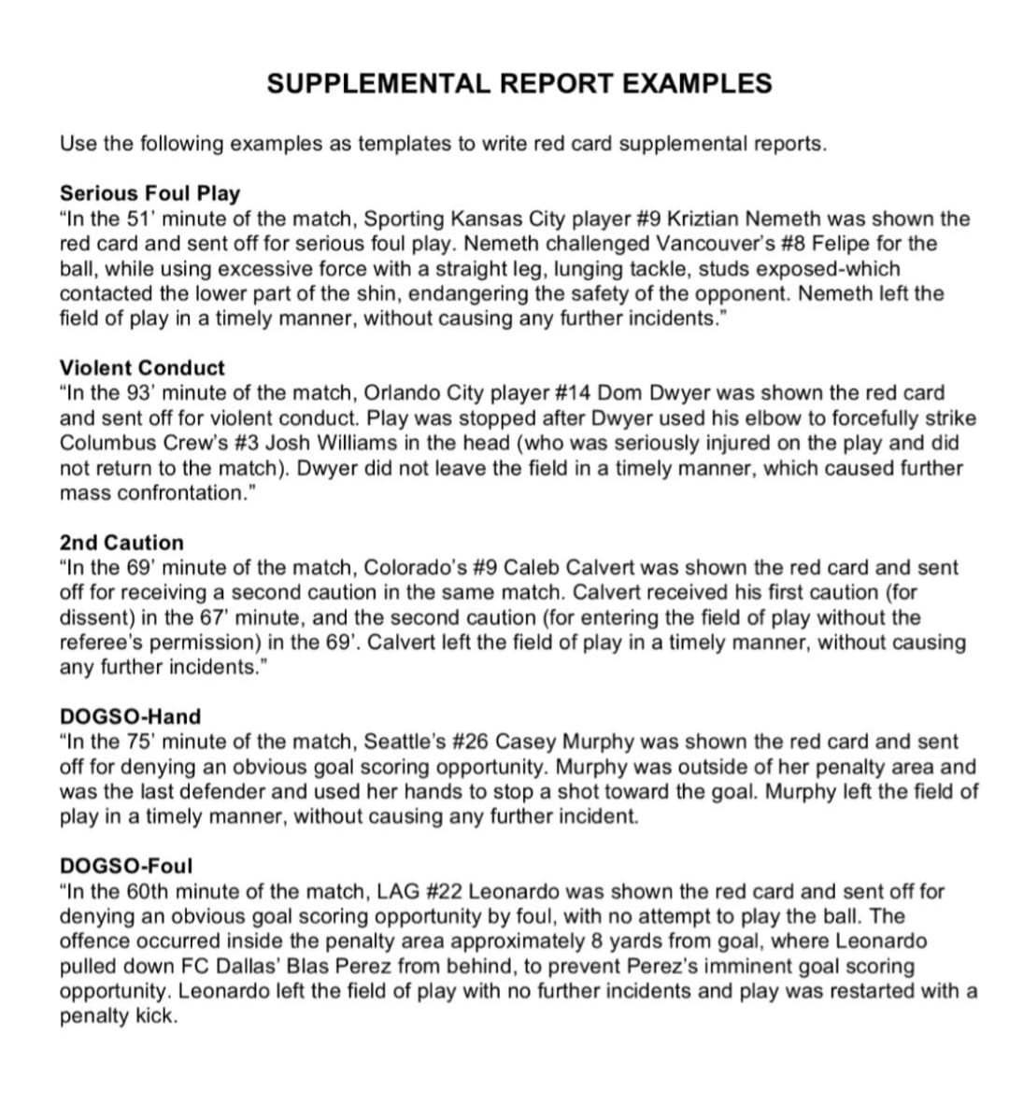
Photo Album
by User

Slide 3
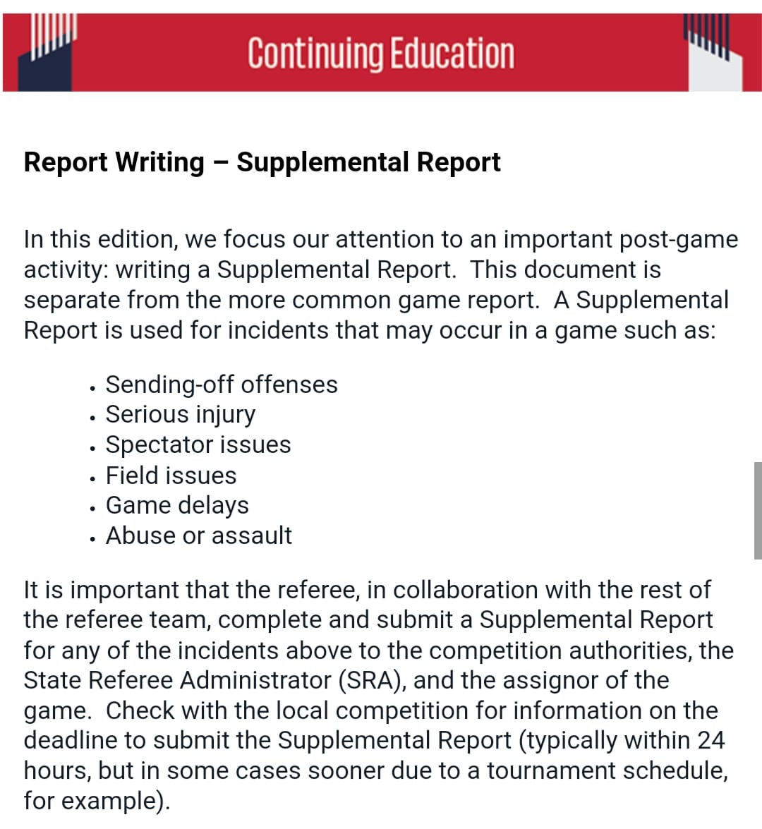

Slide 4
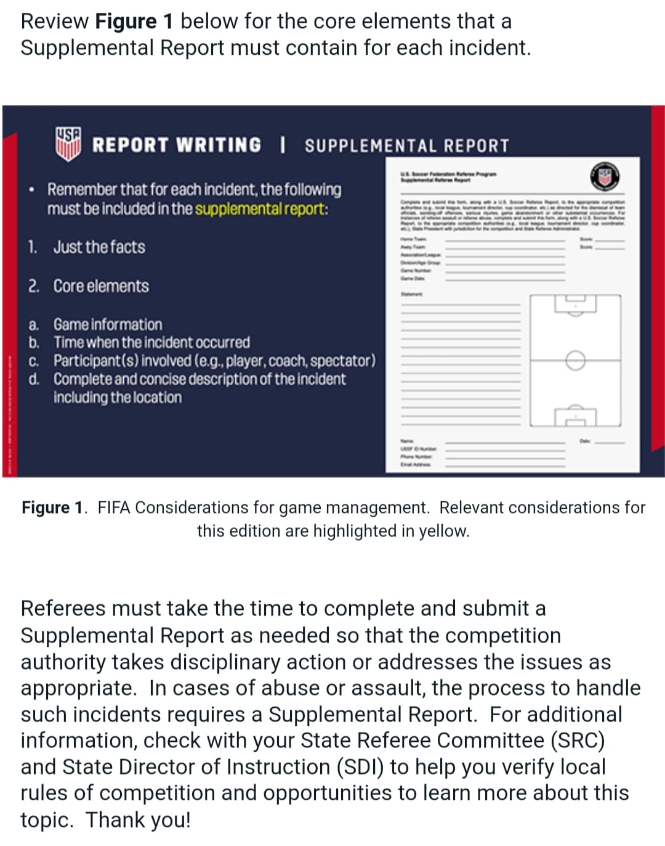

Slide 5
